Slide 1
Phobos Autonomy
System Initial Concept

Slide 2
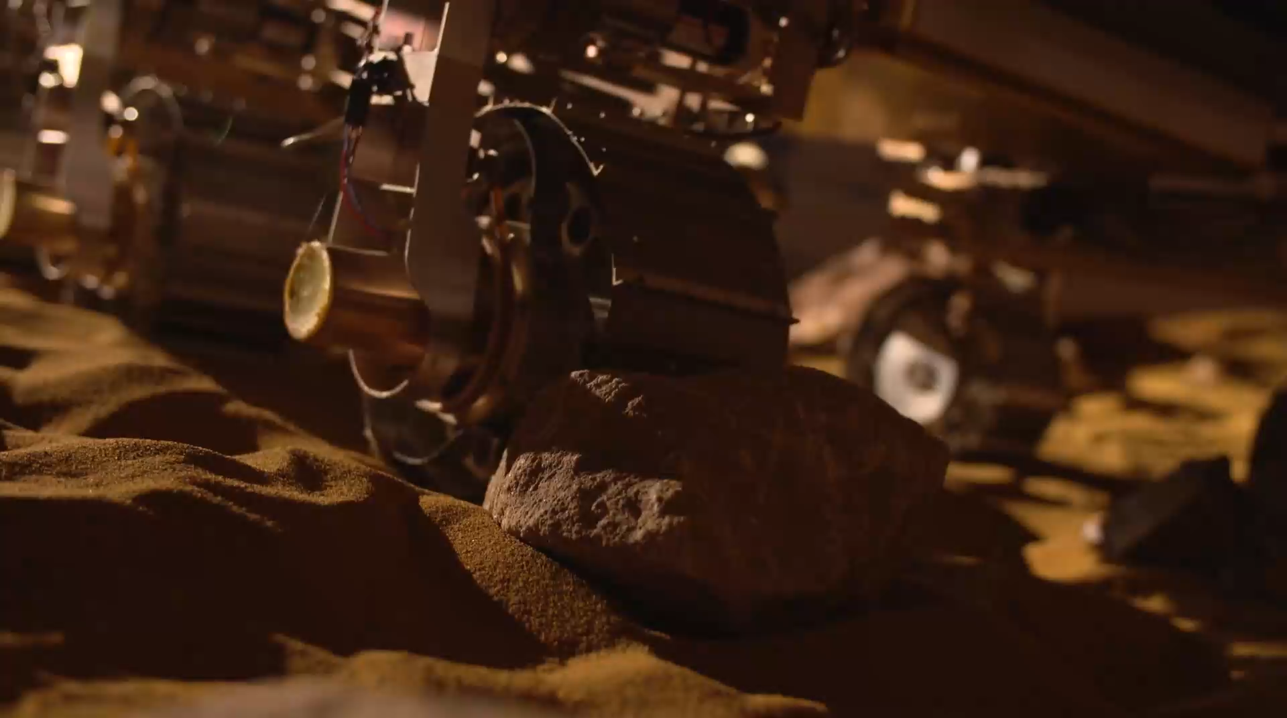
Autonomy Levels
This year
Next year
Level 1: Path following
Autonomy Manger
Trajectory Control
Localisation
Level 2: Obstacle avoidance
Level 1
Perception
Terrain Evaluation
Path Assessment
Level 3: Full autonomy
Level 2
Path planning
https://www.youtube.com/watch?v=ng-YrKmqCtM

Slide 3
Locomotion capability
6 drive wheels, 4 corner wheels have steering capability
Limits manoeuvres to those where the vehicle’s centre of rotation lies along the normal to the middle wheels
This gives two possible manoeuvres:
Ackerman for general driving
Point turn for heading changes
The autonomy system therefore needs to output to lower levels:
Manoeuvre type
Manoeuvre parameters

Slide 4
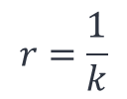
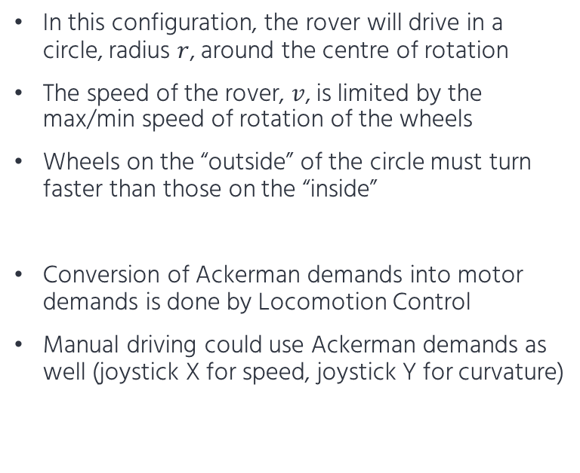
Ackerman Definition
Two parameters to describe any general driving manoeuvre the rover can perform:
Curvature, $k$ [1/m]
Rover body speed, $v$ [m/s]
In this configuration, the rover will drive in a circle, radius $r$, around the centre of rotation
The speed of the rover, $v$, is limited by the max/min speed of rotation of the wheels
Wheels on the “outside” of the circle must turn faster than those on the “inside”
Conversion of Ackerman demands into motor demands is done by Locomotion Control
Manual driving could use Ackerman demands as well (joystick X for speed, joystick Y for curvature)
$$r=\frac{1}{k}$$

Slide 5
Point Turn Definition
One parameter to define a “turn on the spot” manoeuvre:
Rotation rate, $r$ [rad/s]
In this configuration, the rover will turn about its centre
Rotation rate limited by speed of the wheels
Conversion of point turn demands into motor demands is done by Locomotion Control
In manual mode, secondary joystick can be used to demand rotation rate, but mode switching is required to lockout Ackerman demands when executing point turn

Slide 6
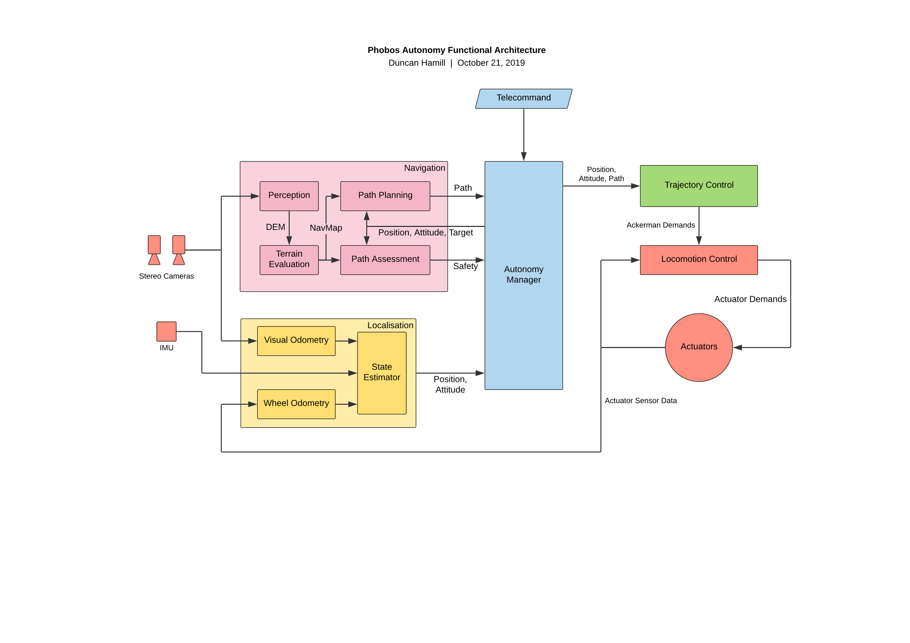
Functional Architecture

Slide 7
Modules

Slide 8
Autonomy Manager
Manages execution of the entire autonomy stack
Accepts telecommands and decides which modules need to be activated for that task
Handles autonomy internal state, makes relevant states available to other modules
Manages cyclic execution (i.e. calls module processing functions at the right time and at the right rate)
Handles any fault events:
Decides how to respond to faults from modules (stop rover, reprocess terrain, etc.)
Sends telemetry back to ground station

Slide 9
Locomotion Control
Decodes Ackerman/point turn demands into actuator level demands
Controls actuators in closed loop to ensure targets are met:
Speed
Position
Monitors actuators for faulty behaviour:
Actuator non-responsive (stopped)
Actuator non-responsive (moving)
Actuator stalled (stuck on rock?)
Backdriving

Slide 10
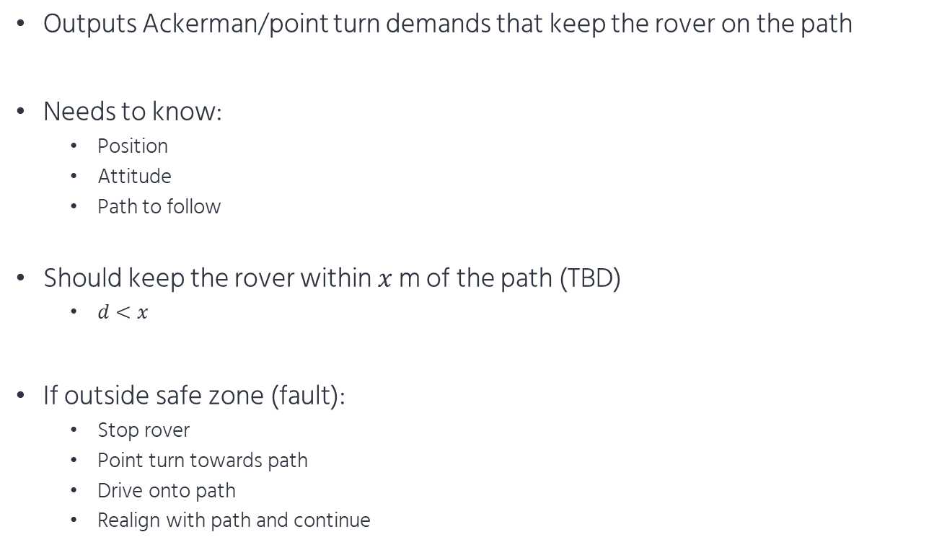

Trajectory Control
Outputs Ackerman/point turn demands that keep the rover on the path
Needs to know:
Position
Attitude
Path to follow
Should keep the rover within $x$ m of the path (TBD)
$d<x$
If outside safe zone (fault):
Stop rover
Point turn towards path
Drive onto path
Realign with path and continue
$$d$$

Slide 11
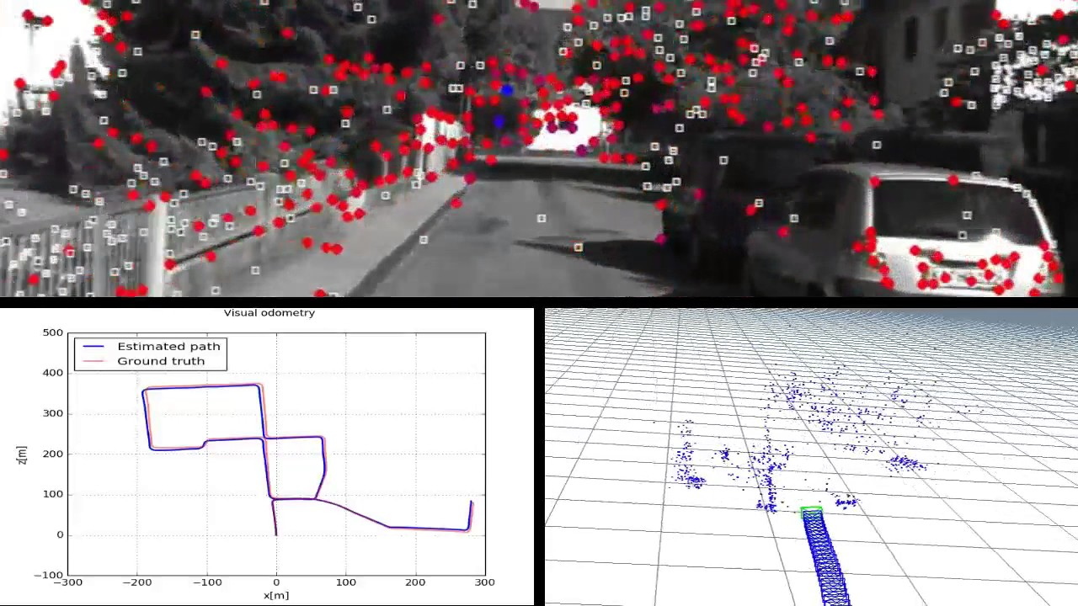
Localisation
Combine sensor inputs to estimate rover position and attitude
IMU provides acceleration and rotation tracking
Noisy and drifty data
Actuator sensors provide wheel odometry data
Cant account for rover slipping on sand, therefore drifts
Stereo cameras provide visual odometry:
Track points across multiple frames
Estimate motion between frames using tracked points
Provides “truth” against the noisy, drifty IMU and wheel odometry
V/O at lower rate than other methods, must propagate IMU/Act data between V/O acquisition times

Slide 12
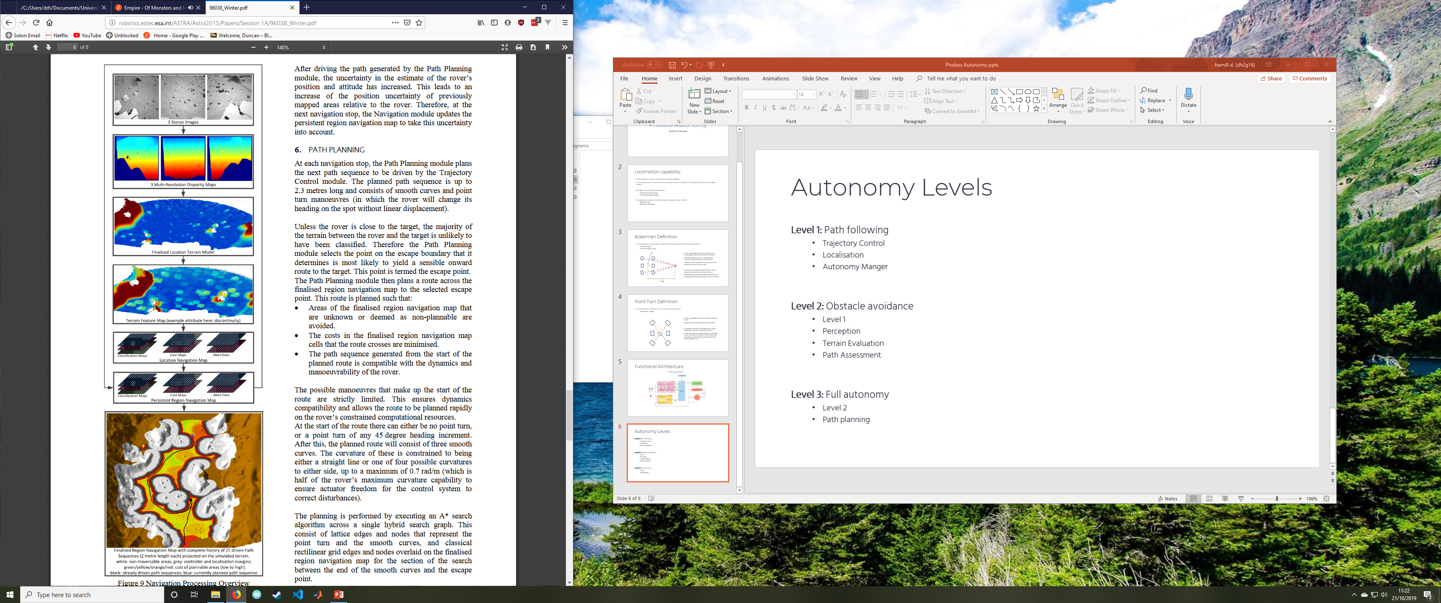
Navigation
Based on ExoMars Nav system (right)
Generate navigation maps from stereo images
Path assessment:
Determine if path provided by ground is safe (passes over safe terrain)
Stop rover if unsafe, or divert around obstacle?
Path planning:
Determine own path through terrain
http://robotics.estec.esa.int/ASTRA/Astra2015/Papers/Session%201A/96038_Winter.pdf

